Slide 1
FOIA Teach-In University of Illinois--Chicago Fall, 2016

Slide 2
Power of FOIA

Slide 3
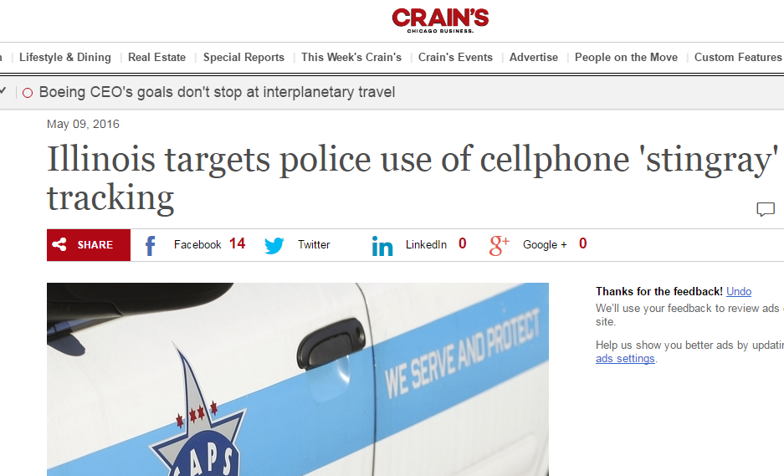
“Stingray”

Slide 4
What to Ask For? -Any document maintained by a public agency -Need not use formal designations for documents

Slide 5
What Is a Public Agency?

Slide 6
5 ILCS 140/7(2): Private companies that contract with a public body to perform public functions are covered!

Slide 7
How Submitted
-In writing
-No special form required
-email allowed

Slide 8
Who do you send an FOIA to?
Public Bodies (not specific office holders)
FOIA Officer

Slide 9
Exemptions
5 ILCS 140/7(1)(e)
“Records that relate to or affect the security of correctional institutions and detention facilities.”

Slide 10
How Long Does It Take?
-5 business days
-Can get extension

Slide 11
How Much Does It Cost
--Electronic = cost of CD
--Paper = 50 pp. free;
15 cents/page

